Slide 1
Abstract Syntax and the Visitor Pattern
COP 4020

Slide 2
Constructing an AST
An AST is only built for syntactically valid programs [according to CFG].
An AST specifies the tree that is constructed during parsing according to concrete syntax.
Operator precedence and associativity is encoded in the constructed tree and need not be represented in the abstract syntax.

Slide 3
Concrete Syntax: expressions
expr ::= term ( ( + | - ) term )*
term ::= factor ( ( * | / ) factor )*
factor ::= INT_LIT | ( expr )
Concrete

Slide 4

Constructing an AST
An AST is only built for syntactically valid programs [according to CFG].
An AST specifies the tree that is constructed during parsing according to concrete syntax.
Operator precedence and associativity is encoded in the constructed tree and need not be represented in the abstract syntax.
(2 + 3) – 4
$$−$$
+
4
2
3

Slide 5
Abstract Syntax
The semantically significant representation of the AST.
We do NOT use the abstract syntax for parsing.
We can define attributes for the simpler abstract syntax and use more complicated translation schemes.

Slide 6
Concrete vs Abstract Syntax: expressions
expr ::= term ( ( + | - ) term )*
term ::= factor ( ( * | / ) factor )*
factor ::= INT_LIT | ( expr )
Concrete
expr ::= INT_LIT | expr (+|-|*|/) expr
Abstract

Slide 7
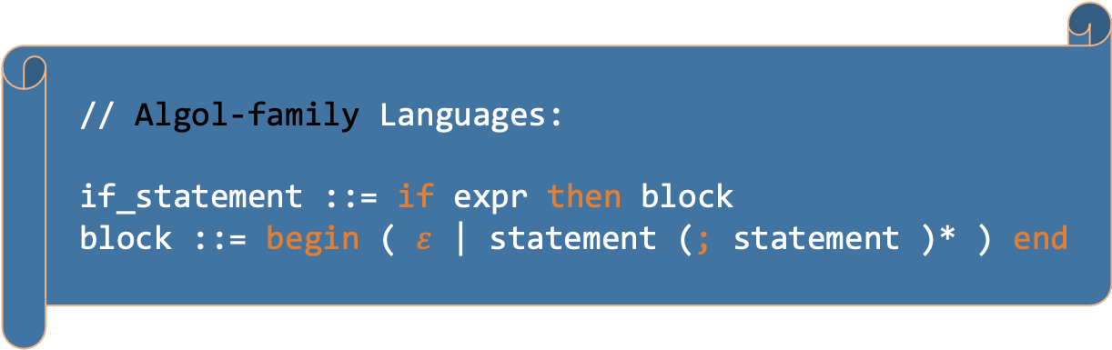
Concrete vs Abstract Syntax: if statements
// C-family Languages:
if_statement ::= if ( expr ) block
block ::= { ( statement ; )* } | statement ;
// Algol-family Languages:
if_statement ::= if expr then block
block ::= begin ( $ε$ | statement (; statement )* ) end

Slide 8
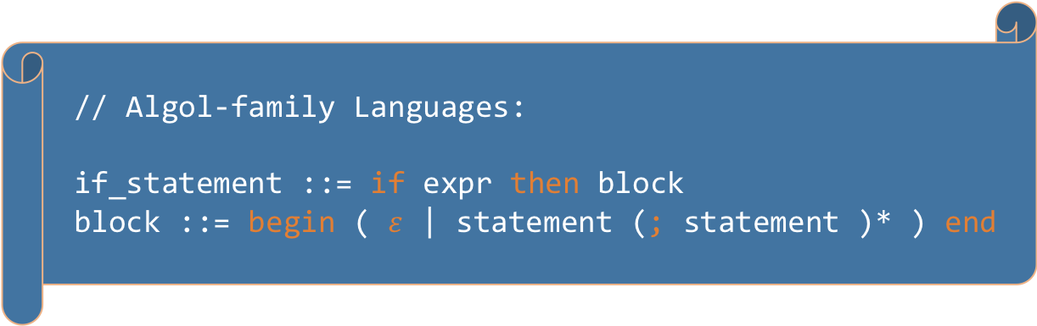
Concrete vs Abstract Syntax: if statements
// C-family Languages:
if_statement ::= if ( expr ) block
block ::= { ( statement ; )* } | statement ;
// Abstract Syntax for both C and Algol
if_statement ::= if expr block
// Algol-family Languages:
if_statement ::= if expr then block
block ::= begin ( $ε$ | statement (; statement )* ) end

Slide 9
Concrete vs Abstract Syntax
Concrete
Concrete syntax for expressions is complicated [expr, term, factor LHS productions] in order to handle precedence and associativity of operators as well as provide overriding through parentheses.
Abstract
Abstract syntax no longer specifies the precedence of operators – the AST constructed during parsing incorporates the structure to define precedence.
We do not parse abstract syntax.
Therefore, we do not care if the grammar meets constraints such as FIRST, FOLLOW, PREDICT, LL(1), and so on.

Slide 10
OO Implementation of an AST
All nodes in AST are subclasses of a common base class.
In a compiler, we could use the visitor pattern to traverse the tree for type checking and code generation (or interpretation).
Building the visitor pattern:
Define a class for each non-terminal in the abstract syntax.
If there are multiple productions for a non-terminal, make the non-terminal class abstract and introduce a subclass for each production.

Slide 11
expr ::= INT_LIT | expr ( + | - | * | / ) expr
abstract class AST
abstract class Expr extends AST{…}
class IntLitExpr extends Expr{…}
class BinaryOpExpr extends Expr{…}
// further language elements might be…
abstract class Statement extends AST{…}
class IfStatement extends Statement{…}

Slide 12
expr ::= INT_LIT | expr ( + | - | * | / ) expr
abstract class AST
abstract class Expr extends AST{…}
class IntLitExpr extends Expr{…}
class BinaryOpExpr extends Expr{…}
// further language elements might be…
abstract class Statement extends AST{…}
class IfStatement extends Statement{…}
Resembles
your project!
Extract principles from the example!

Slide 13
expr ::= INT_LIT
class IntLitExpr extends Expr {
public final Token literal;
public IntLitExpr(Token literal) {
this.literal = literal;
}
// as needed add properties to hold attributes
// used in type checking and code generation
}

Slide 14
expr ::= expr ( + | - | * | / ) expr
class BinaryOpExpr extends Expr {
public final Expr e0;
public final Token op;
public final Expr e1;
public BinaryOpExpr(Expr e0, Token op, Expr e1) {
this.e0 = e0;
this.op = op;
this.e1 = e1;
}
}

Slide 15
Modifications to factor
Recall the concrete syntax: factor ::= INT_LIT | ( expr )
If the factor is an INT_LIT, the factor method returns an IntLitExpr node.
If the factor is a parenthesized expression, the factor method returns an Expr node corresponding to the expr in place.

Slide 16
factor ::= INT_LIT | ( expr )
Expr factor() {
Expr e = null;
if ( token.isType(INT_LIT) ) {
e = new IntLitExpr(token); consume();
}
else if ( token.isType(LPAREN) ) {
consume(); e = expr(); match(RPAREN);
}
else error();
return e;
}

Slide 17

Modifications to expr
Recall the concrete syntax: expr ::= term ( ( + | - ) term )*
Needs to return an Expr
Either the Expr corresponding to the single term or a BinaryOpExpr
An expression like 2 + 3 – 4 returns a sub-tree whose structure represents the left associativity of the operators.
$$−$$
+
4
2
3

Slide 18
expr ::= term ( ( + | - ) term )*
Expr expr() {
Expr e0 = null, e1 = null;
e0 = term();
while ( token.isType(PLUS) || token.isType(MINUS) ) {
Token op = token;
consume();
e1 = term();
e0 = new BinaryOpExpr(e0, op, e1);
}
return e0;
}

Slide 19
Visitor Pattern
[Mostly] separate code for what to do when traversing a data structure from the code for the data structure itself.
Traversal code encapsulated in a Visitor class.
Action taken at a node can depend on the type of the node and the type of the Visitor [double dispatch].
Useful in compilers because we:
Traverse AST multiple times with different purposes [type checking, code generation, interpretation, … ].
What happens at a node depends on the node’s type.
Compiler generator tools usually incorporate support for the visitor pattern.

Slide 20
A Data Structure for the Visitor Pattern
Define: interface Visitor
Include a method visitX for each node type X in the data structure.
For node type X, the method in the interface has the same signature. Here is the generalized method signature.
public Object visitX( X node, Object arg );

Slide 21
Interface ASTVisitor
interface ASTVisitor {
public Object visitIntLitExpr(IntLitExpr e, Object arg);
public Object visitBinaryOpExpr(BinaryOpExpr e, Object arg);
}

Slide 22
Abstract Class AST
Add an [abstract] visit method to the [abstract] superclass of all the nodes in the data structure. Remark: in some descriptions of the Visitor pattern, this method is called accept instead of visit.
abstract class AST {
public abstract Object visit(ASTVisitor v, Object arg);
}

Slide 23
Class IntLitExpr
In class X, the visit method returns the Object that is the result of calling: v.visitX(this, arg).
class IntLitExpr extends Expr {
public final Token literal;
public Object visit(ASTVisitor v, Object arg) {
return v.visitIntLitExpr(this, arg);
}
}

Slide 24
Class BinaryOpExpr
In class X, the visit method returns the Object that is the result of calling: v.visitX(this, arg).
class BinaryOpExpr extends Expr {
public final Expr e0;
public final Token op;
public final Expr e1;
public Object visit(ASTVisitor v, Object arg) {
return v.visitBinaryOpExpr(this, arg);
}
}

Slide 25
Implementing the Visitor Pattern
Create a class that implements the interface Visitor.
Requires an implementation of each method in the interface.
Recall that the interface contains a method for each node type in the data structure.
Works well for traversing and decorating an AST according to an L-attributed grammar [refer to our discussion of Semantic Analysis].

Slide 26
Sample Implementation
Reference the grammar for expressions.
Use the visitor pattern to evaluate expressions (interpration).
In a typical compiler, we would also use the visitor pattern to check type constraints and generate code.
expr ::= INT_LIT | expr (+|-|*|/) expr

Slide 27
Attribute Grammar for Expression Evaluation
expr ::= INT_LIT
expr.val = INT_LIT.val

Slide 28
Attribute Grammar for Expression Evaluation
expr ::= INT_LIT
expr.val = INT_LIT.val
expr₀ ::= expr₁ + expr₂
expr₀.val = expr₁.val + expr₂.val
expr₀ ::= expr₁ – expr₂
expr₀.val = expr₁.val – expr₂.val
expr₀ ::= expr₁ * expr₂
expr₀.val = expr₁.val * expr₂.val
expr₀ ::= expr₁ / expr₂
expr₀.val = expr₁.val / expr₂.val
[refer to our discussion of Semantic Analysis]

Slide 29
Class Expr with Abstract Syntax
class Expr extends AST {
public Integer val;
}
Abstract Syntax for expr has attribute val
Add a field for the attribute to the class Expr
The val field is inherited by BinaryOpExpr and IntLitExpr

Slide 30
Implement Visitor
class ExprEvalVisitor implements ASTVisitor {
public Object visitIntLitExpr(IntLitExpr e, Object arg) {
// decorate node
e.val = e.literal.val;
// pass synthesized attribute to parent
return e.val;
}
// continued…

Slide 31
// … class ExprEvalVisitor continued
public Object visitBinaryOpExpr(BinaryOpExpr e, Object arg) {
int val0;
int val1 = (Integer) e.e0.visit(this, null);
int val2 = (Integer) e.e1.visit(this, null);
switch( e.op.getType() ) {
case PLUS: val0 = val1 + val2; break;
case MINUS: val0 = val1 - val2; break;
case TIMES: val0 = val1 * val2; break;
case DIV: val0 = val1 / val2; break;
}
e.val = new Integer(val0);
return e.val;
}
} // end class ExprEvalVisitor

Slide 32
To Compute the Value of an Expression
// Create a parser instance
// (pass an appropriate token stream)
Parser parser = new Parser(tokens);
// Call the Parser’s parse method to generate AST
AST ast = parser.parse();
// Create an instance of a visitor
ExprEvalVisistor v = new ExprEvalVisitor();
// Call the visit method of the ast
Integer value = (Integer) ast.visit(v, null)

Slide 33
To Compute the Value of an Expression
Of course, expressions can be evaluated with a simpler program.
// Create a parser instance
// (pass an appropriate token stream)
Parser parser = new Parser(tokens);
// Call the Parser’s parse method to generate AST
AST ast = parser.parse();
// Create an instance of a visitor
ExprEvalVisistor v = new ExprEvalVisitor();
// Call the visit method of the ast
Integer value = (Integer) ast.visit(v, null)
Here we have shown an example scenario for using the Visitor Pattern on an AST

